Slide 1

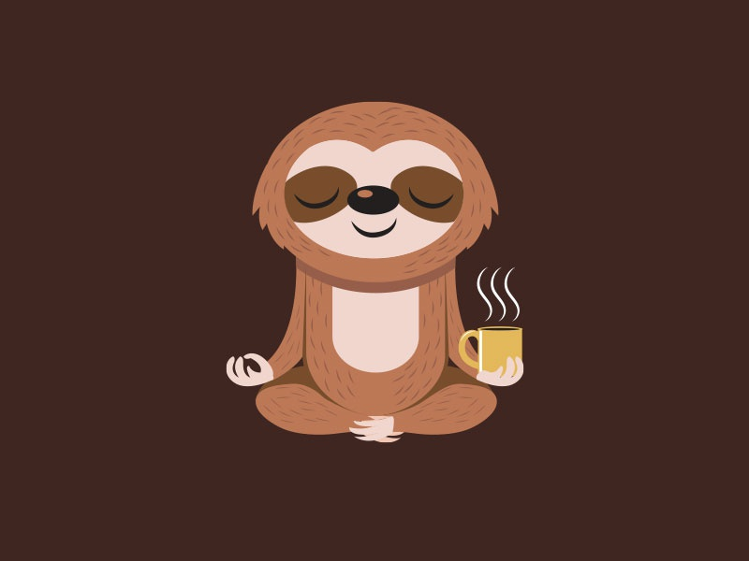
Currently on break
Music Status Checker

